Slide 1
A Few Observations on Part 130 of the ITAR
Steven W. Pelak
Holland & Hart LLP
Washington, D.C.
November 2017
This briefing provides general information on pertinent legal topics. The statements made and any materials distributed as part of the seminar are provided only for educational purposes. They do not constitute legal advice nor do they necessarily reflect the views of Holland & Hart LLP or any of its attorneys other than the speaker. This briefing does not create an attorney-client relationship between you and Holland & Hart LLP. Consult your legal counsel with specific questions.
Copyright Holland & Hart LLP 2017. All Rights Reserved.

Slide 2
Thank You
This briefing provides general information on pertinent legal topics. The statements made and any materials distributed as part of the seminar are provided only for educational purposes. They do not constitute legal advice nor do they necessarily reflect the views of Holland & Hart LLP or any of its attorneys other than the speaker. This briefing does not create an attorney-client relationship between you and Holland & Hart LLP. Consult your legal counsel with specific questions.
Copyright Holland & Hart LLP 2017. All Rights Reserved.

Slide 3
ITAR Part 130 Brief Introduction
Background & Context to Part 130
1. General Background and Purpose of ITAR Part 130 – Why?
2. U.S. Government’s Enforcement of ITAR Part 130 – The Broader Context
3. General Rule and Requirements of Part 130 – What does Part 130 Require?
Observations & Suggestions for Action and Pondering
a. Cooperative Efforts with International FBI Squads
b. Part 130 – Revision – Alternative Reporting Option
c. Defense Security Cooperation Agency (DSCA) Reporting to Congress - ???

Slide 4
ITAR Part 130 – What is it? and Why?
“Part 130” – Part of the International Traffic in Arms Regulations - “ITAR”
ITAR regulates and controls the export and temporary import of defense articles/defense services
Federal Law - Title 22 of the Code of Federal Regulations at § 130
Who implements and administers the ITAR?
U.S. Department of State, Directorate of Defense Trade Controls – “DDTC”
Part 130 Rule: Disclosure of Political Contributions, Fees or Commissions in relation to Foreign Sales of Defense Articles/Services
In relation to export license/authorization applications to DDTC or a Foreign Military Sale, the License Applicant or Supplier of the Defense Systems must Disclose to the DDTC (a) Political Contributions and (b) Fees/Commissions for the promotion, solicitation, or otherwise to secure the sale
An Anti-Corruption Disclosure or Transparency Provision – Not a Prohibition upon Payments

Slide 5
Origins of ITAR Part 130 – WHY?
Disclosure & Transparency: Watergate Scandal & Lockheed Aircraft Bribery – Watergate Special Prosecutor uncovers more than can resolve.
The Church Committee - U.S. Senator Frank Church
Church Committee held a series of hearings in 1975 focusing on Lockheed, Northrop, Gulf Oil, Mobil Oil
SEC testimony detailed U.S. corporations’ use of secret funds for improper foreign payments – 60+ Actions
Arms Export Control Act, § 39 (1976) and Part 130 of the ITAR (1977)
Transparency & Disclosure to Deter Corrupt Payments to Obtain Defense Sales to Foreign Governments
A Foreign Policy Matter – The flag follows the weapons
Market Theory – Disclosure will promote, over time, the better product and better service over sellers who rely upon corrupt payments to foreign officials to secure sales
Foreign Corrupt Practices Act (1977)

Slide 6
Congress Demands Reporting: By the Executive Branch & the Defense Trade Industry
Section 39 of the Arms Export Control Act (AECA, 22 U.S. Code § 2779) – Federal Law:
U.S. Secretary of State shall require:
adequate and timely reporting on political contributions, gifts, commissions and fees
paid, offered or agreed to be paid, by any person
in connection with a sale of defense articles or defense services to or for the armed forces of a foreign country or international organization
in order to solicit, promote or otherwise to secure the conclusion of such sale
AECA authorizes State Department to prohibit such payments
DDTC chose not to prohibit – Adopted a Disclosure/Transparency Rule
Prohibition left to more generally applicable federal law where corrupt intent – Foreign Corrupt Practices Act (FCPA), Anti-Fraud laws, etc.

Slide 7
Congress Demands Reporting: By the Executive Branch & the Defense Trade Industry
Congressional Notification by Executive Branch:
AECA requires Executive Branch to Report Part 130 Payments in connection with its Notification to Congress of Certain Defense Sales –
AECA – 22 U.S.C. 2776(a)(7) and 2776(b)(1)
Disclosure to Congress - ITAR Sections 123.15, 124.11, 130.17
Information treated as Confidential Business Information – ITAR Section 130.15
Applications for DDTC Licenses and Manufacturing License Agreements (MLAs) and Technical Assistance Agreements (TAAs) - Umbrella Authorizations by DDTC
Require Disclosure of Part 130 Payments – Political Contributions and Fees/Commissions
Lack of Identity between MLAs/TAAs and Commercial Sales – Practical Business Records Problems

Slide 8
ITAR Part 130 – Recent Enforcement Actions
Recent State Department/DDTC Part 130 Enforcement Actions:
Esterline Technologies Corp. - 2014
$20 million penalty for 282 alleged ITAR violations, including alleged failure to report fees or commissions paid to Brazil agent in furtherance of $1.9 million sale of technical services related to cockpit control system
No suggestion in Charging Letter of potential corrupt payments to foreign officials
BAE Systems plc - 2011
$79 million civil penalty for 2,599 alleged violations of AECA and ITAR, including three Part 130 violations, arising from exportation of various defense articles to numerous countries over course of roughly 13 years
$400 million criminal penalty after pleading guilty to criminal conspiracy to violate FCPA, AECA, and ITAR (including Part 130)

Slide 9
Overview of ITAR Part 130 – What is Required?
Reporting Obligation – Not Prohibition
Duty to Report to State Department/DDTC –
Certain Payments in relation to Sales of Defense Articles and Defense Services
Which Payments?
1. Political Contributions
2. Fees or Commissions

Slide 10
ITAR Part 130 – Which Payments to Report?
DDTC Reporting Requirements of Certain Payments
Political Contributions
Applicants and suppliers must report to DDTC
whether they or any of their vendors have paid, offered or agreed to pay
Political Contributions in an aggregate amount of $5,000 or more
NOTE – Duty to collect information from others, vendors and those receiving “fees or commissions” (sales representatives, suppliers, consultants, etc.)

Slide 11
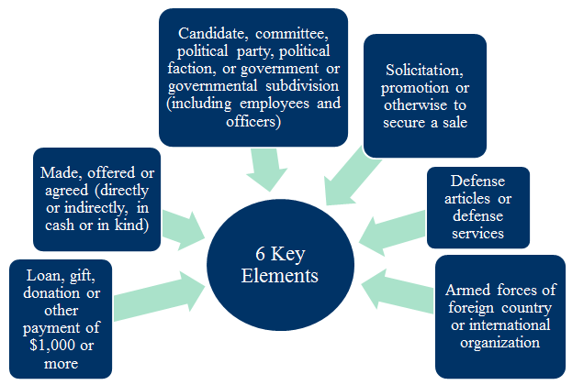
ITAR Part 130 – Reporting Duty
Reporting Political Contributions to DDTC:

Slide 12
“Fees or Commissions” – Which Payments to Report?
“Fees or Commissions” –
Applicants and suppliers must report to DDTC
whether they or any of their vendors (distributor or manufacturer who supplies applicant $500K+ defense articles) have paid, offered or agreed to pay
Fees or Commissions in an aggregate amount of $100,000 or more
What is a “Fee or Commission”? - Broad Definition
“Any loan, gift, donation or other payment of $1,000 or more made, or offered or agreed to be made directly or indirectly, whether in cash or in kind, and whether or not pursuant to a written contract”
“To or at the direction of any person, irrespective of nationality, whether or not employed by or affiliated with an applicant, a supplier or a vendor; and
“For the solicitation or promotion or otherwise to secure the conclusion of a sale of defense articles or defense services to or for the use of the armed forces of a foreign country or international organization.

Slide 13
ITAR Part 130 – What Not Reported?
Fee or Commission Exclusions – Does NOT Include:
(1) Normal salary (excluding contingent compensation) – salary established at an annual rate and paid to a regular employee;
(2) General advertising or promotional expenses – where not directed to any particular sale or purchaser; or
(3) Technical/Operational/Advisory Services –
Payments made, or offered or agreed to be made, solely for the purchase of specific goods or technical, operational or advisory services, which payments are not disproportionate in amount with the value of the specific goods or services actually furnished; or
(4) Political contributions/payments not otherwise captured by Part 130.

Slide 14
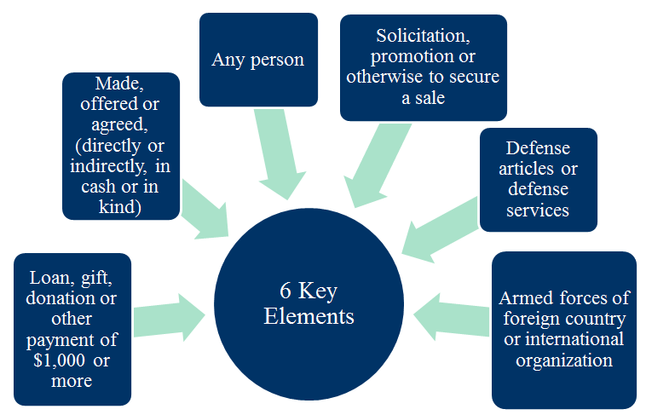
ITAR Part 130 – Reporting Duty
Reporting Fees or Commissions to DDTC:

Slide 15
A Few Topics – Potential Action Items
Observations & Suggestions for Action and Pondering
a. Cooperative Efforts with International FBI Squads – Relatively New “FCPA” Squads
b. Part 130 – Revision – Alternative Reporting Option
c. Defense Security Cooperation Agency (DSCA) Reporting to Congress - ???
The Rule of Law: Our Common Goal
This briefing provides general information on pertinent legal topics. The statements made and any materials distributed as part of the seminar are provided only for educational purposes. They do not constitute legal advice nor do they necessarily reflect the views of Holland & Hart LLP or any of its attorneys other than the speaker. This briefing does not create an attorney-client relationship between you and Holland & Hart LLP. Consult your legal counsel with specific questions.
Copyright Holland & Hart LLP 2017. All Rights Reserved.

Slide 16
Thank You
This briefing provides general information on pertinent legal topics. The statements made and any materials distributed as part of the seminar are provided only for educational purposes. They do not constitute legal advice nor do they necessarily reflect the views of Holland & Hart LLP or any of its attorneys other than the speaker. This briefing does not create an attorney-client relationship between you and Holland & Hart LLP. Consult your legal counsel with specific questions.
Copyright Holland & Hart LLP 2017. All Rights Reserved.

