Slide 1
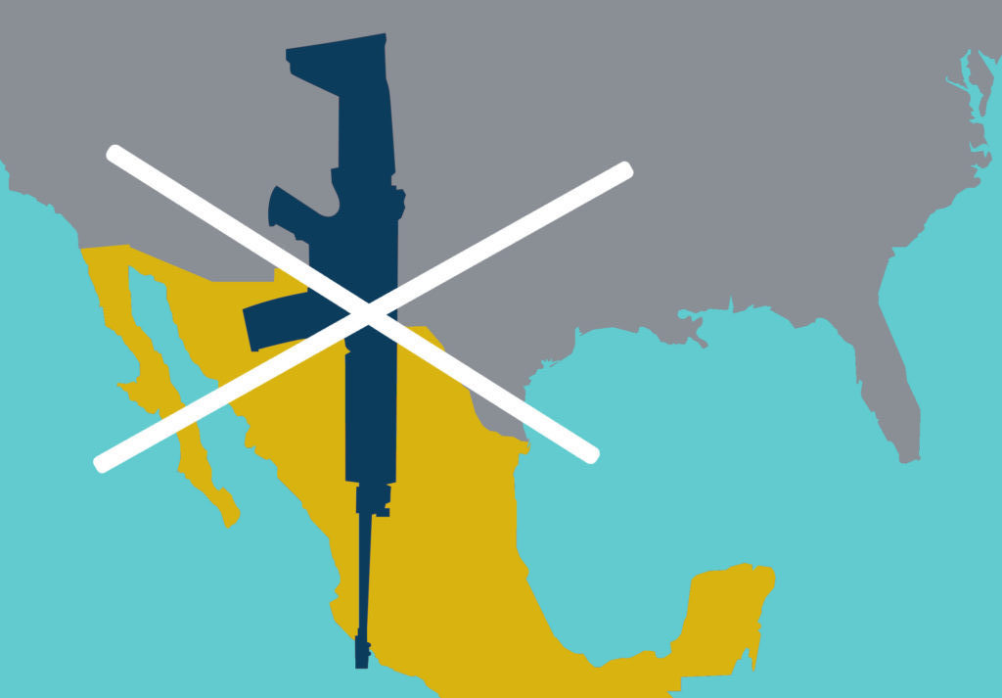
US Firearms Exports to Mexico
& Central America
John Lindsay-Poland, Stop US Arms to Mexico
www.stopusarmstomexico.org
March 24, 2022
Notes:
We will be talking about events and realities, the very knowledge of which can be toxic or evoke experiences of pain or trauma. We need to breathe. If you need to take a break, please do. Also know that we are here for each other.
In my experience, when I take in this type of knowledge, it is important that I do something with it. If I don’t, it can hurt me. Doing something can be protesting, can be art, can be music, can be organizing. For me, writing is the best.
I will share a lot of information, but we will get to what we can do. Hold on.

Slide 2
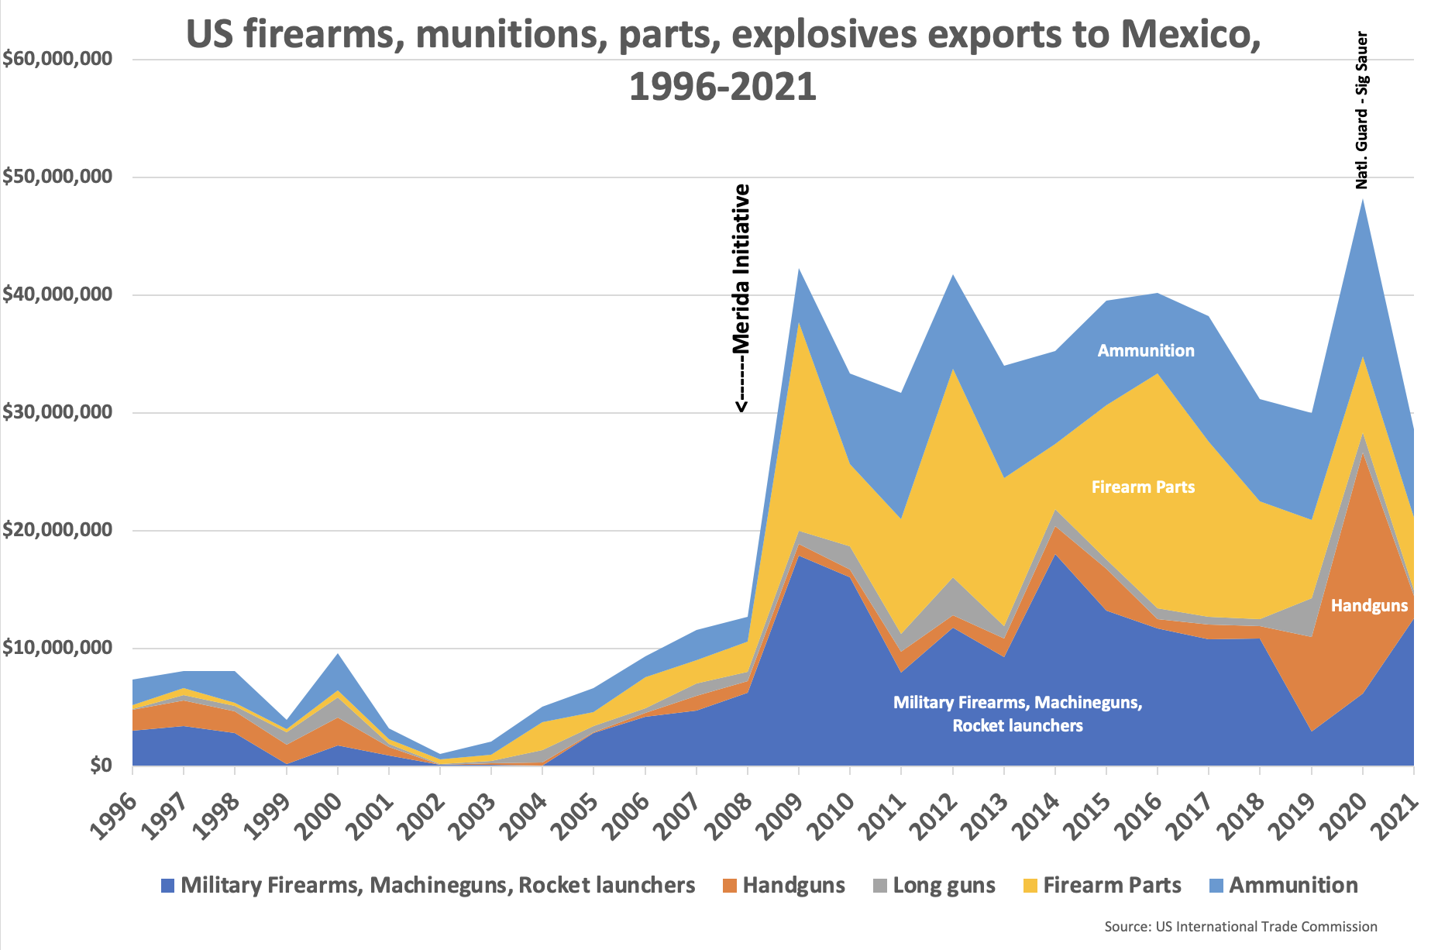
Notes:
Importation entirely through military, nearly all for police and military use.

Slide 3
US firearms exported to N. Triangle countries and Belize, 2001-2021
Source: US International Trade Commission

Slide 4
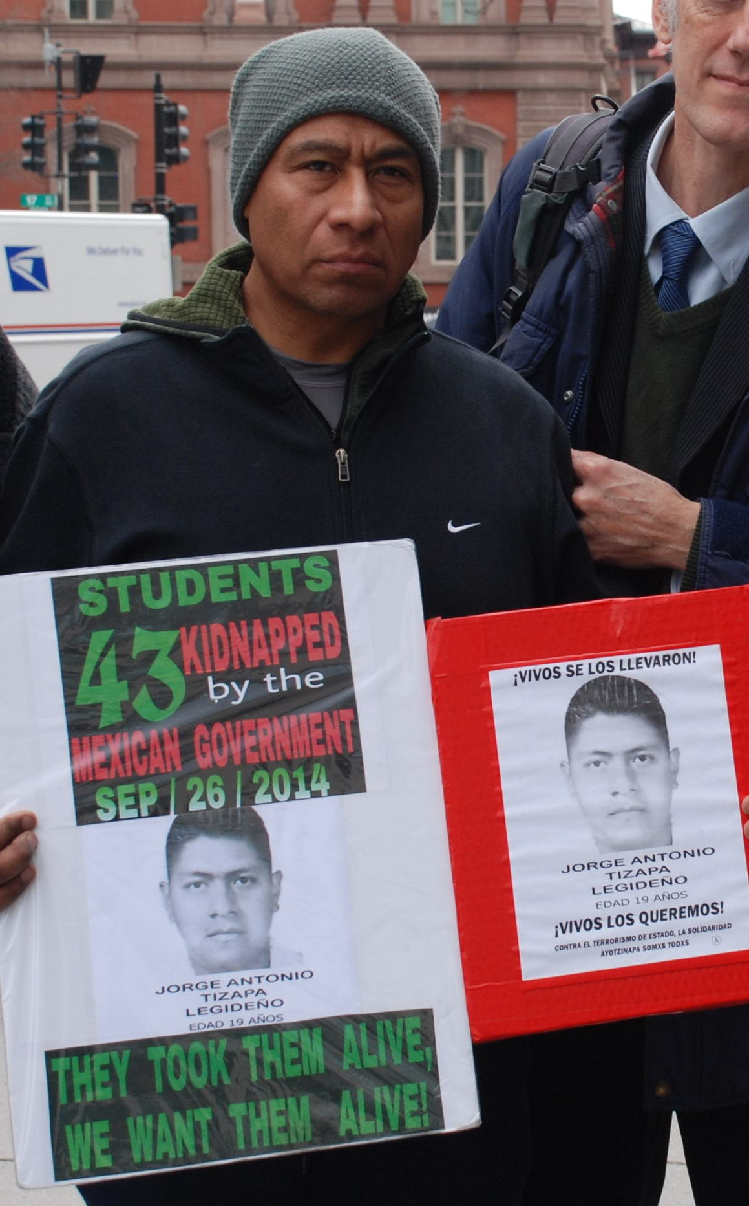
“Mexico has acquired exorbitant quantities of weaponry and munitions, and the people at large have no idea of the magnitude of these weapons purchases, which also end up with organized crime.
I think that if you were in my place, in the place of the mothers and fathers of these 43 young men and knew that these weapons were used in the disappearance of one of your family members, you would be doing the same thing that I am doing.”
- Antonio Tizapa, father of Jorge Antonio Tizapa Legideño, one of 43 Ayotzinapa disappeared students

Slide 5
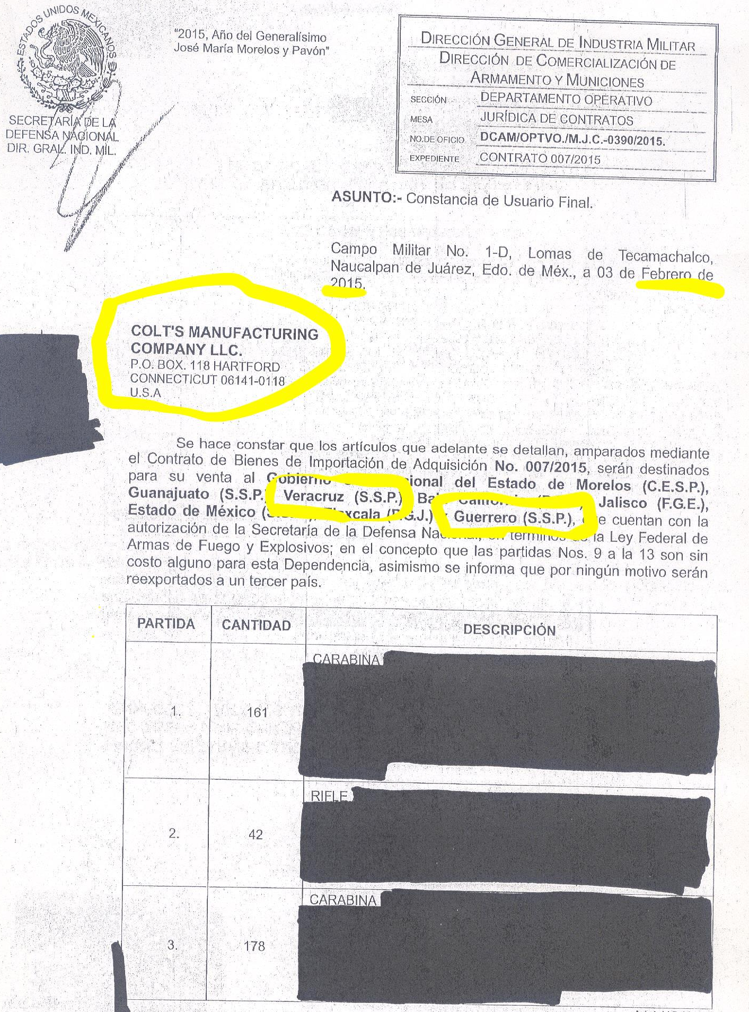
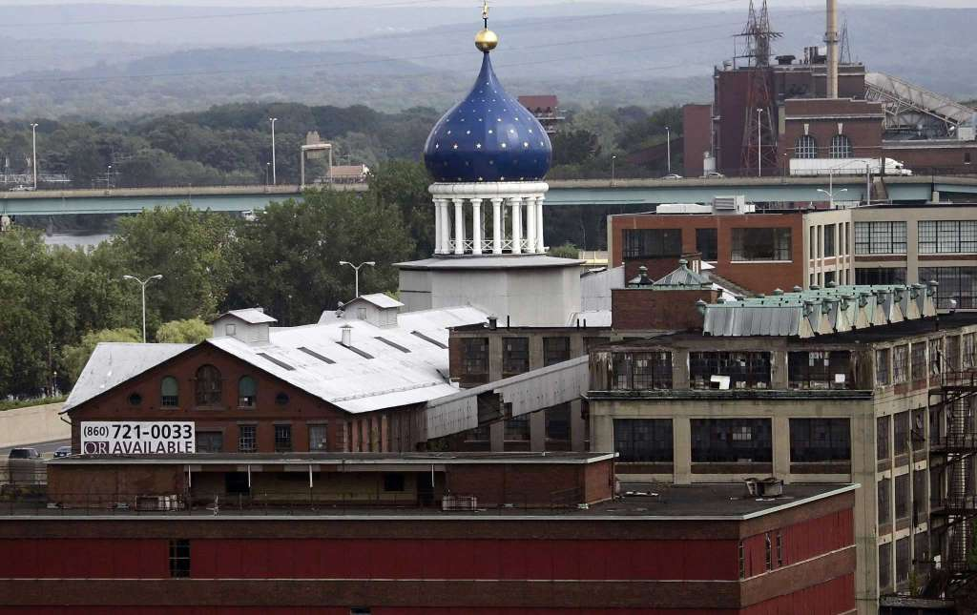
End user certificate for Colt assault rifles Colt exported to Mexico for use by state police, including Guerrero – only 5 months after the disappearance of the 43 Ayotzinapa students
Colt Industries, Hartford

Slide 6
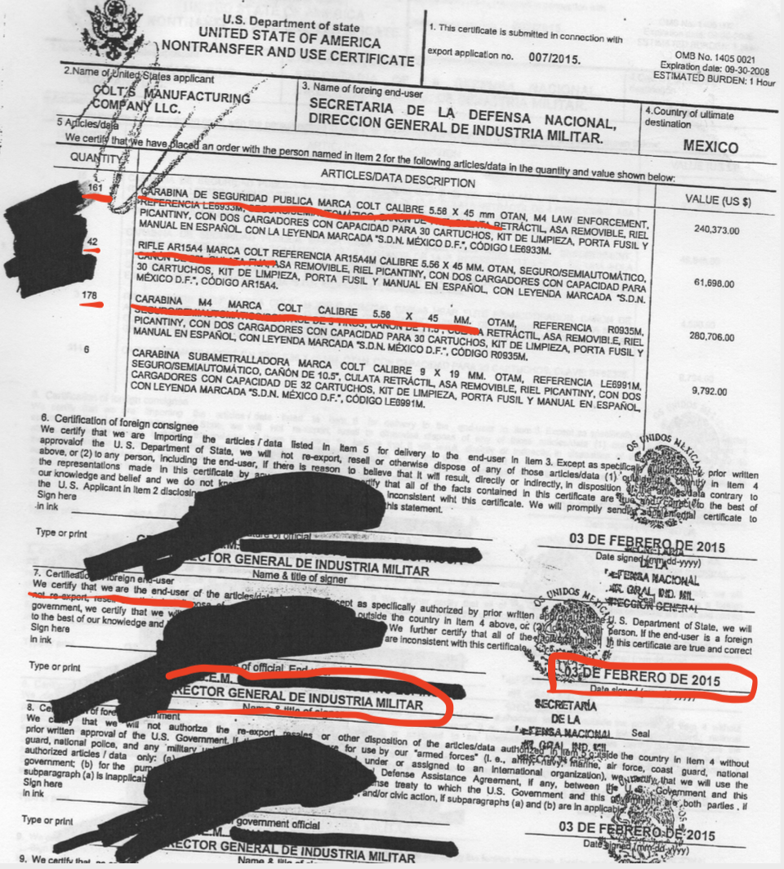

Slide 7
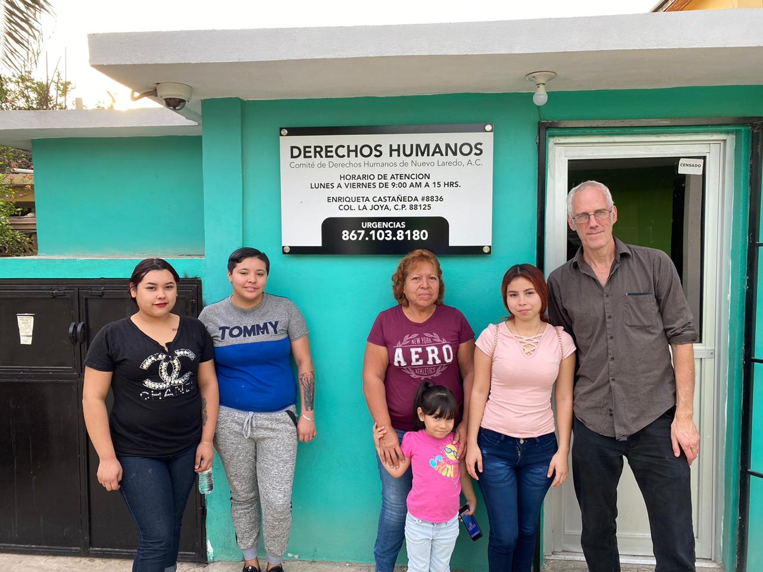
Family members of eight people killed by Tamaulipas state police agents in Nuevo Laredo, Sept. 2019

Slide 8
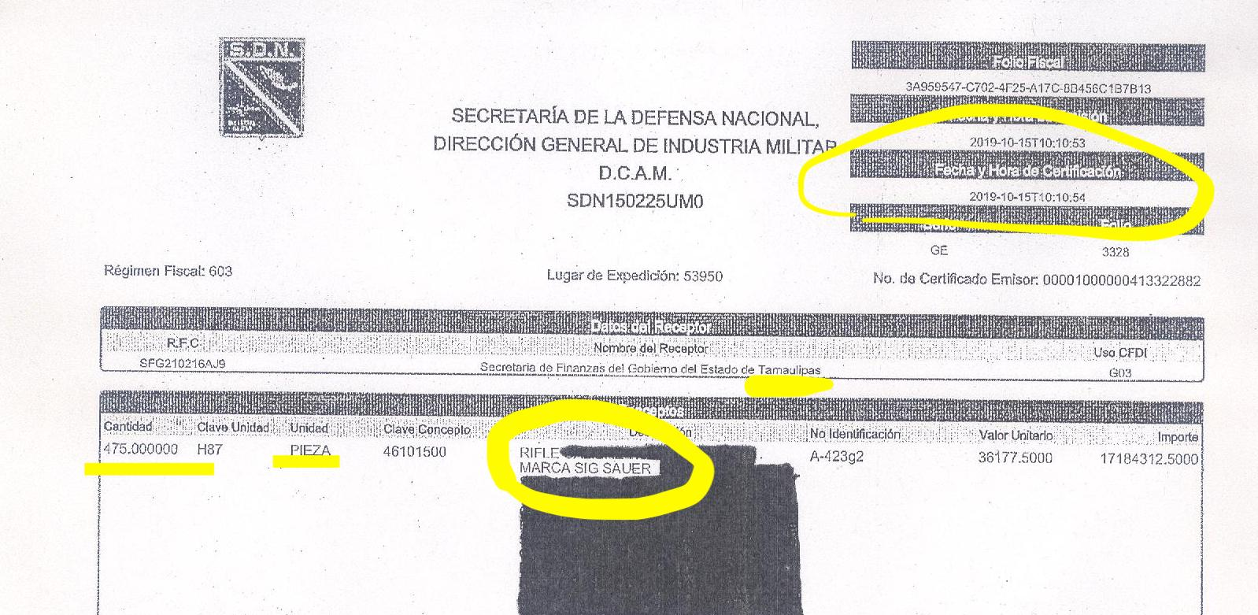
Sig Sauer exported hundreds of rifles to Tamaulipas state police a month
AFTER they were implicated in massacre in Nuevo Laredo

Slide 9
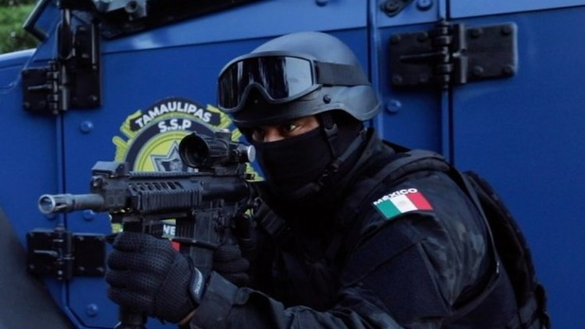
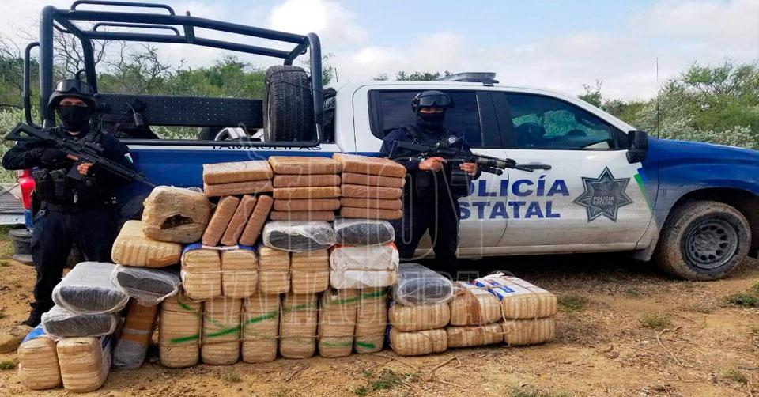
Special Operations Group (GOPES) of Tamaulipas state police:
Armed with Sig Sauer assault rifles
Trained in Texas in 2019 with Starr County police
Source: https://insightcrime.org/news/united-states-special-operations-massacre-mexico

Slide 10
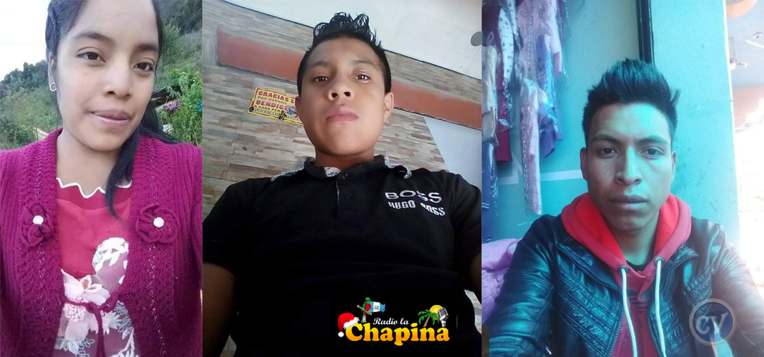
Massacre of 16 Guatemalan migrants in Camargo, Tamaulipas, January 2021: 12 Tamaulipas GOPES state police agents charged
L to R, from top:
Osmar Neftalí Miranda Baltazar; Anderson Marco Antulio Pablo Mauricio; Dora Amelia López Rafael;
Paola Damaris Zacarías Gabriel;
Rubelsy Elias Tomas Isidro;
Santa Cristina García Pérez.

Slide 11
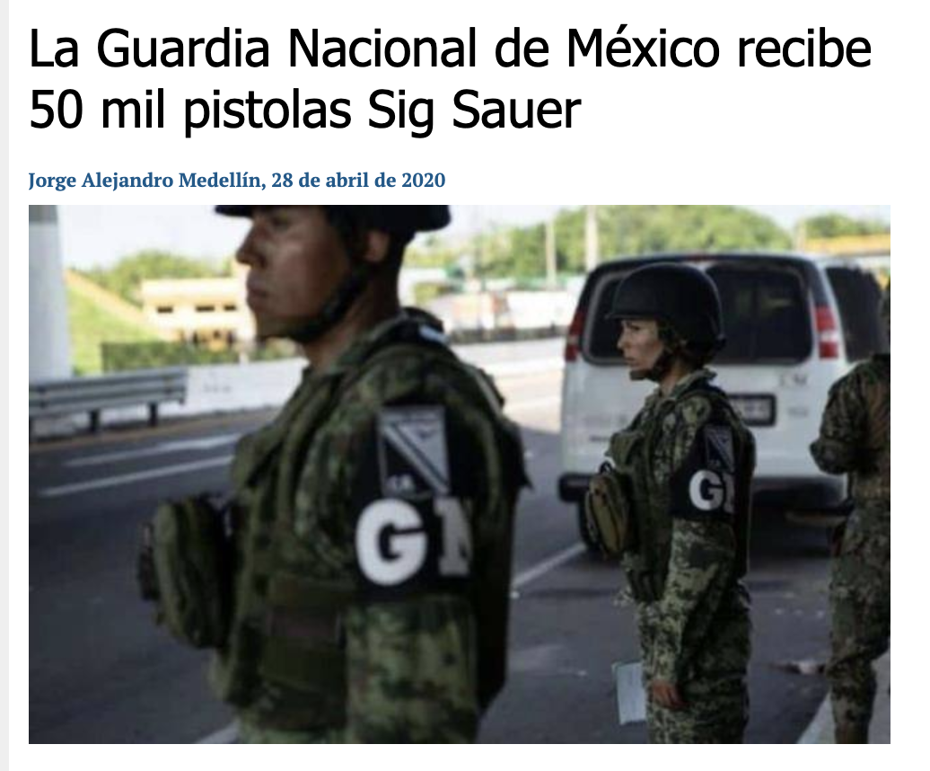
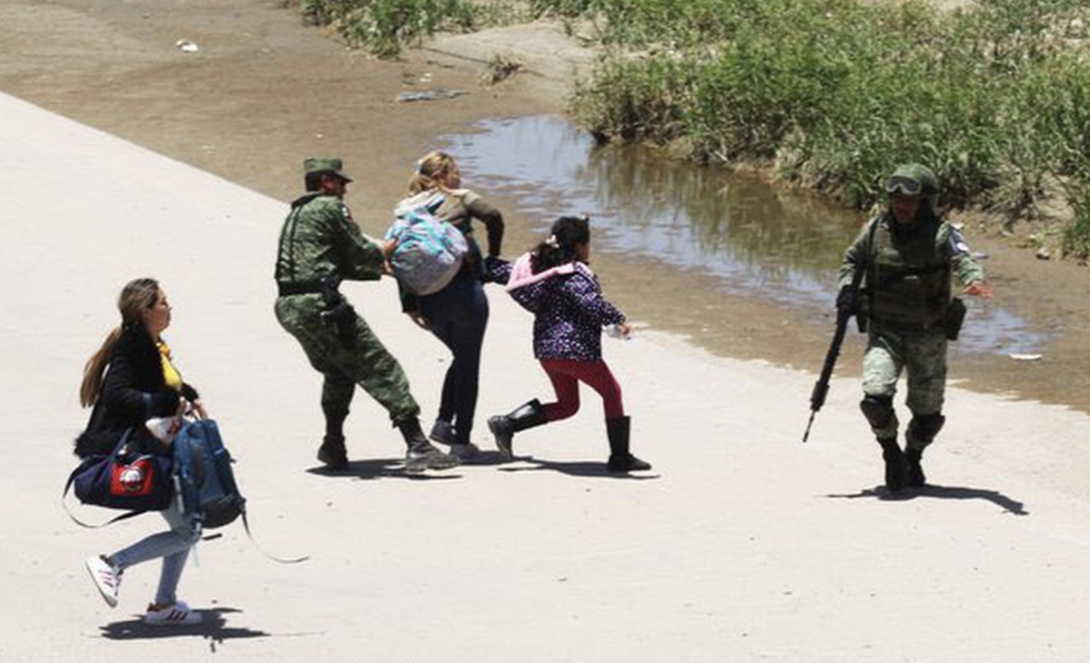
National Guard armed with 50,000 Sig Sauer weapons to detain & deport migrants

Slide 12
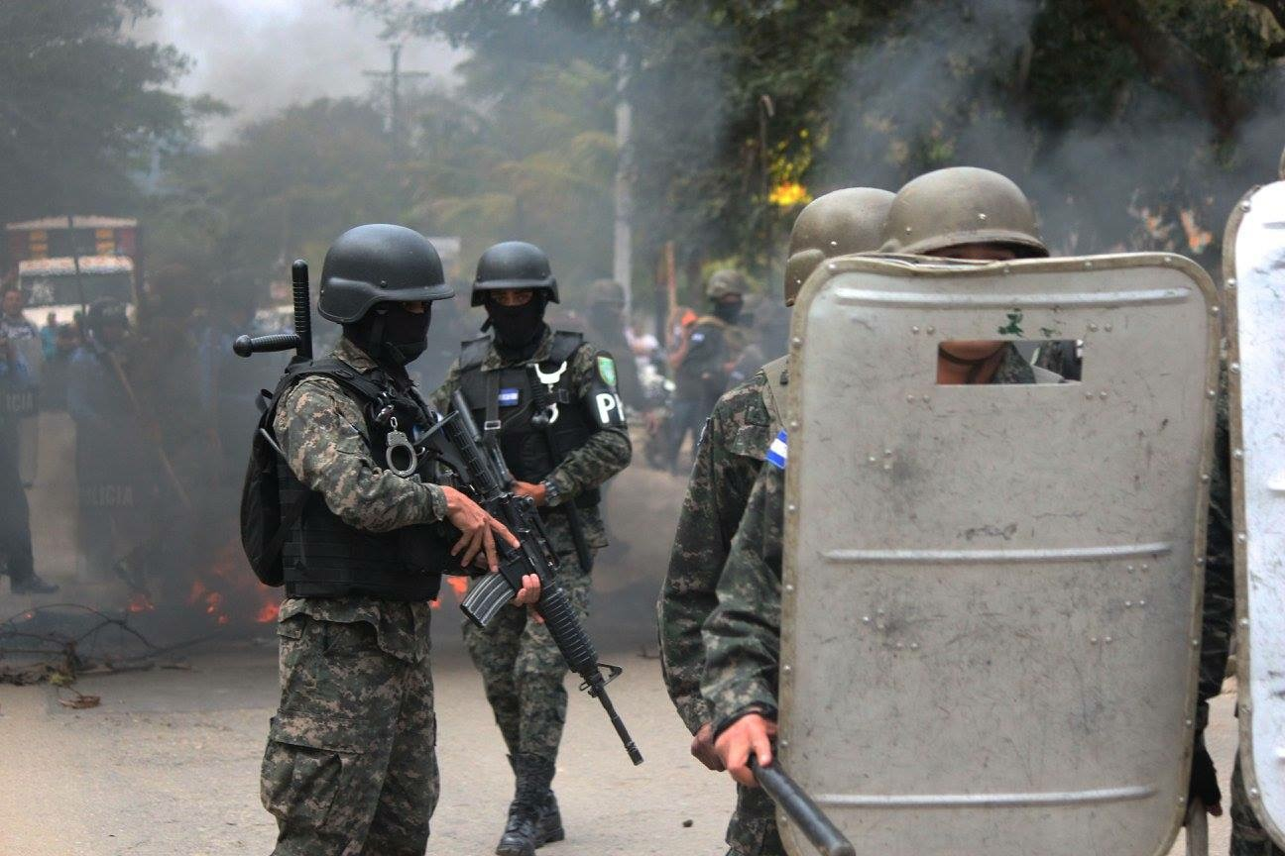
Honduran police armed with Colt rifles who fired on protesters of electoral fraud, 2018
Source: Miami Herald

Slide 13
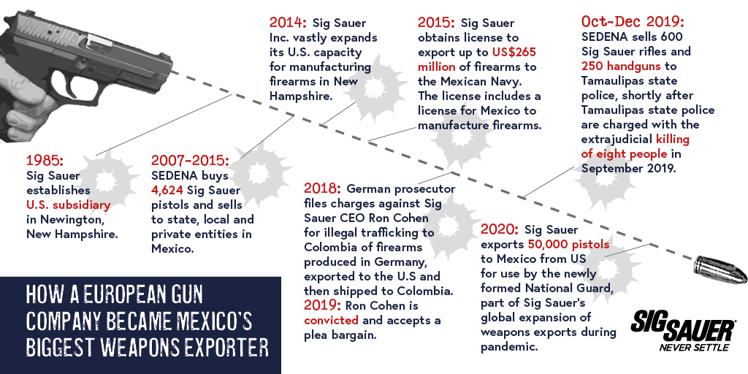
Source: Global Exchange and Mexican Commission for Defense and Promotion of Human Rights

Slide 14
Lack of end user restrictions on DDTC licenses
“In general, and as a matter of policy and practice, DDTC does not apply unit-level provisos to licenses, as the licenses are granted to the exporting parties, who do not have a means of enforcing such provisos after delivery, in the way that, for example, the U.S.G. may be able to do in the context of government-to-government foreign military sales.”
- State Dept response to staff question, August 2021

Slide 15
Identifying where US weapons exports go
Senate’s State and Foreign Operations bill (not included in Omnibus):
None of the funds appropriated by this Act may be used to issue licenses, or assist another Federal agency in issuing licenses, for the sale or export of firearms or ammunition to a government security force in Mexico or Central America unless the Secretary of State determines and reports to the appropriate congressional committees that such government—
(i) is implementing end use agreements, including providing end user certificates, to prevent the transfer of such firearms or ammunition to individuals or units implicated in serious crimes or not authorized in such agreements or certificates to receive such items; and
(ii) will maintain a record of the users of such firearms and ammunition for the purpose of regular audits.

Slide 16
More information
Global Exchange / Stop US Arms to Mexico
www.stopusarmstomexico.org
Forum on the Arms Trade:
www.forumarmstrade.org/catitoiii.html
Contact:
John Lindsay-Poland, johnlindsaypoland@gmail.com

